Slide 1

London Slums
By Tammy Donahue

Slide 2
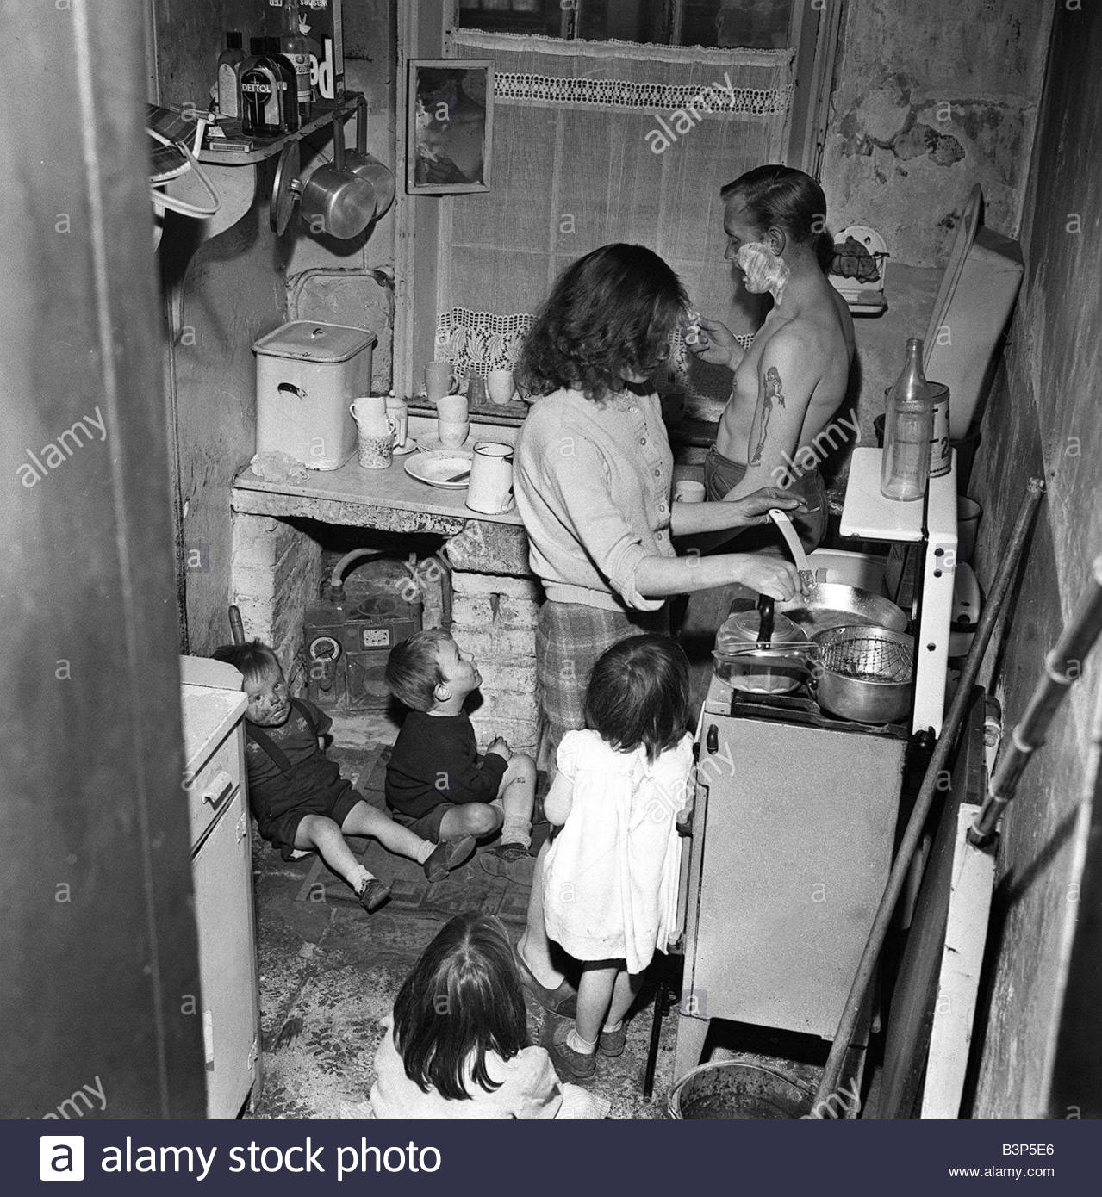
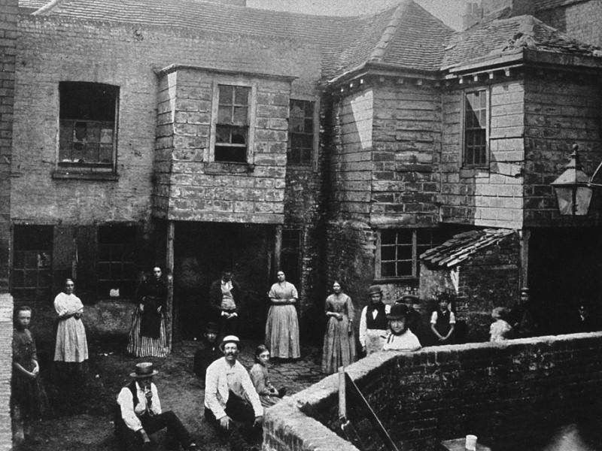
Originally built for one family
Owners put one family per room

Slide 3
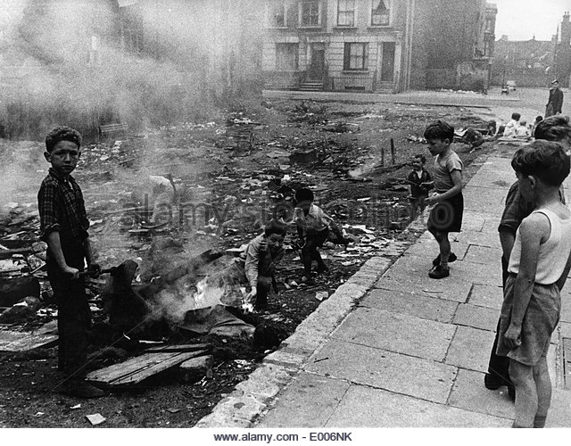
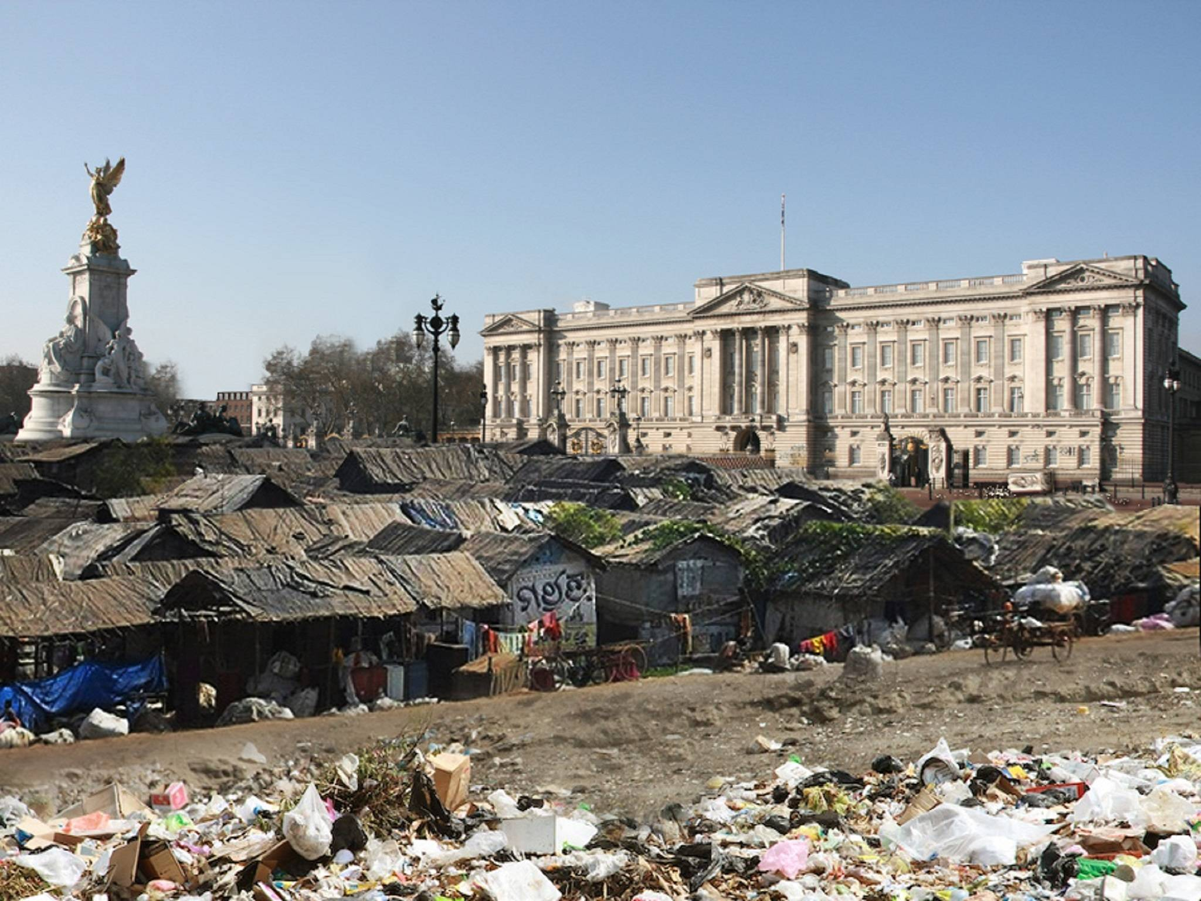
Most rich and well off believed that slums were because of sins and/or laziness
East end of London worst slums

Slide 4
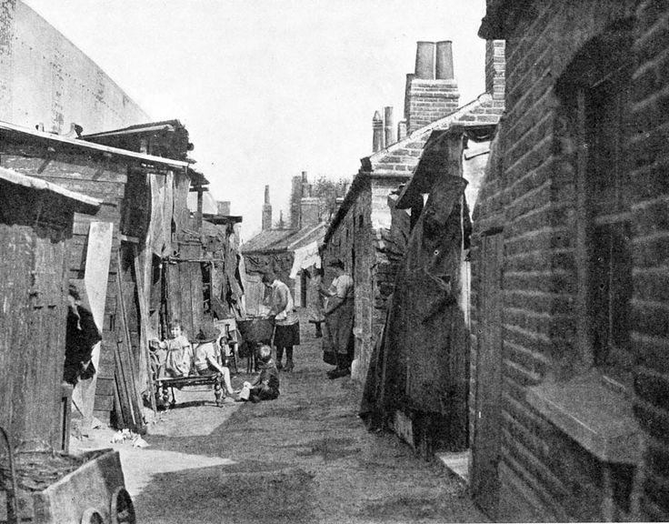
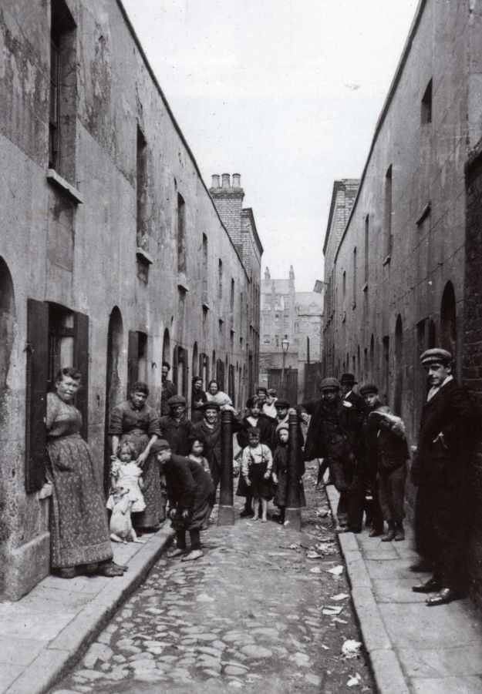
Homes were not built with a solid structure
Some had no ventilation

Slide 5
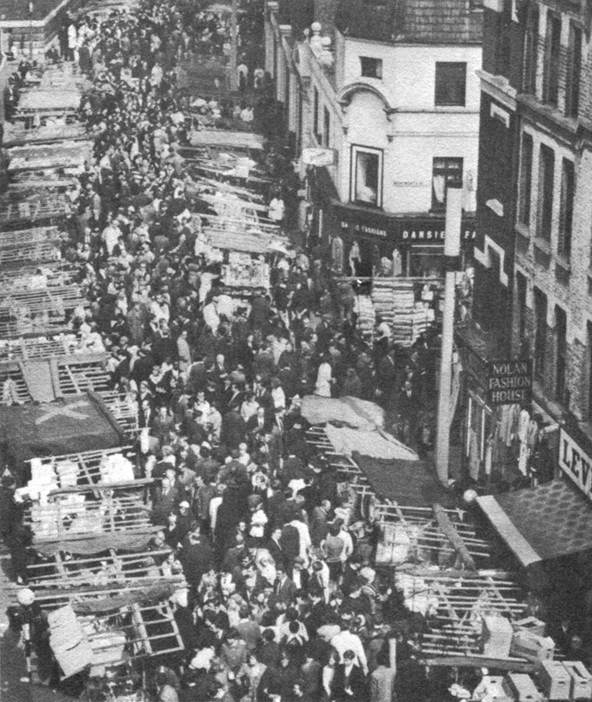
Some rent a bed by day or night that was rented by someone else
Population grew and problems got worse (over 4 million population growth)

Slide 6

https://www.alamy.com/stock-photo/slum-london.html
http://sulabhenvis.nic.in/WriteReadData/UserFiles/slum-britain-2-buckingham.jpg
https://www.pinterest.com/juliecranston20/victorian-poorpovertyslumsworkhouse/
http://www.victorianweb.org/history/slums.html
https://www.npr.org/2015/03/12/392332431/dirty-old-london-a-history-of-the-victorians-infamous-filth
https://www.lifedeathprizes.com/spooky-stuff/londons-victorian-slums-63294
https://www.historyextra.com/period/victorian/life-in-19th-century-slums-victorian-londons-homes-from-hell/

